Slide 1
DSA503: Statistical Inference
(Credits: 3)
Review of Important Concepts

Slide 2
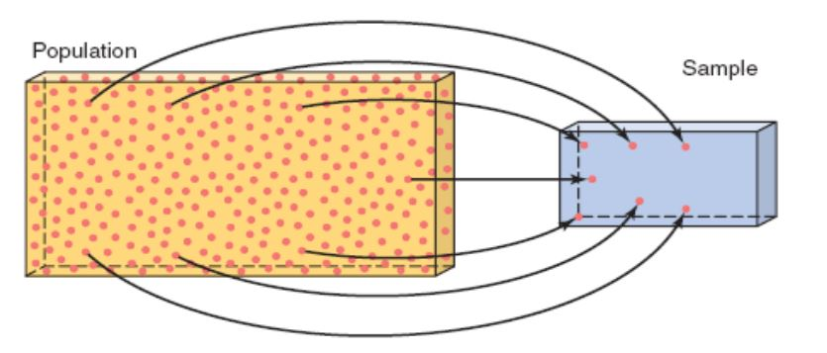
Population versus Sample
A population consists of all elements: individuals, items, or objects – whose characteristics are being studied.
A representative part of the population is referred to as a sample.

Slide 3
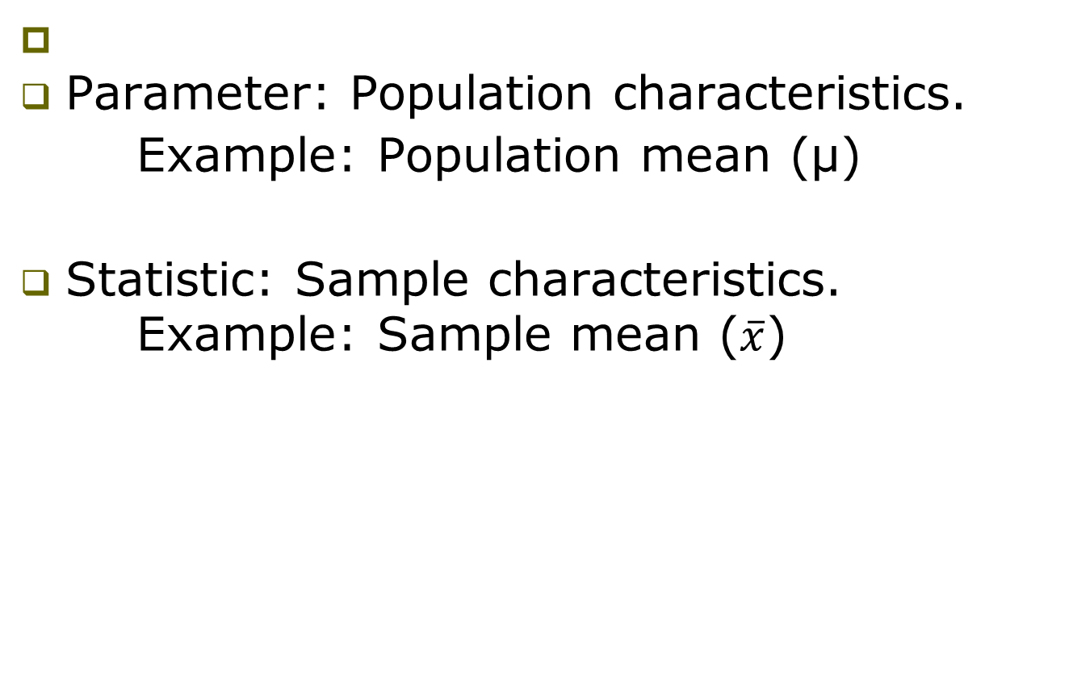
Parameter vs. Statistic

Slide 4
Population & Sampling distributions
Population Distribution
Sampling Distribution

Slide 5
Population Distribution
Definition
The population distribution is the probability distribution of the population data.

Slide 6
Population distribution
Suppose there are only five students in DSA503 class.
Midterm scores:
  70 78 80 80 95
Let x denote the score of a student.

Slide 7
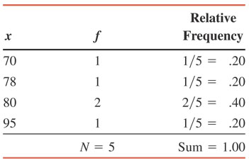
Population Frequency & Relative Frequency Distributions

Slide 8
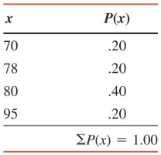
Population Probability Distribution

Slide 9
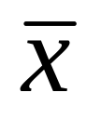
Sampling Distribution
Definition: The probability distribution of a statistic is called its sampling distribution.
Example: The probability distribution of is called its sampling distribution.

Slide 10
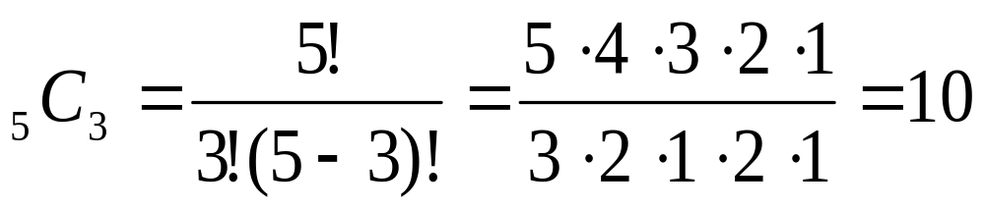
Sampling Distribution
Reconsider the earlier population of midterm scores of 5 students.
Consider all possible samples of 3 scores (without replacement).
Total number of possible samples:

Slide 11
Sampling Distribution
Suppose we assign:
  A = 70, B = 78, C = 80, D = 80 E = 95
Then 10 possible samples:
  ABC, ABD, ABE, ACD, ACE, ADE, BCD, BCE, BDE, CDE.

Slide 12
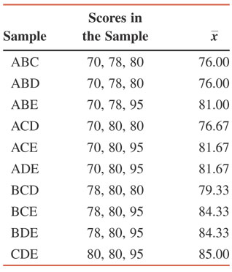
All possible samples and their means when sample size is 3

Slide 13
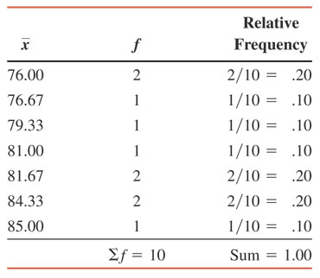
Frequency and relative frequency distributions of when the sample size is 3

Slide 14
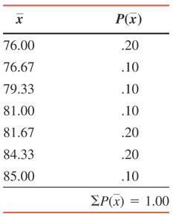
Sampling Distribution of When the Sample Size is 3

Slide 15
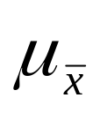
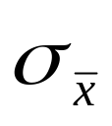
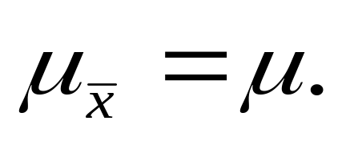
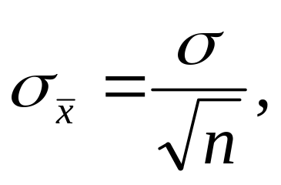
Mean and standard deviation of
The mean and standard deviation of the sampling distribution of are denoted by and , respectively.
The mean of is always equal to the mean of the population. Thus
The standard deviation of is
where σ is the standard deviation of the population and n is the sample size.
Proof: HW

Slide 16
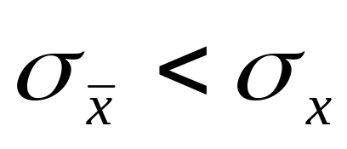
Two Important Observations
The spread of the sampling distribution of is smaller than the spread of the corresponding population distribution, i.e.
2. The standard deviation of the sampling distribution of decreases as the sample size increases.

Slide 17
Example
The mean wage for all 5000 employees who work at a large company is $27.50 and the standard deviation is $3.70. Let be the mean wage per hour for a random sample of certain employees selected from this company.
Find the mean and standard deviation of for a sample size of
(a) 30 (b) 75 (c) 200

Slide 18
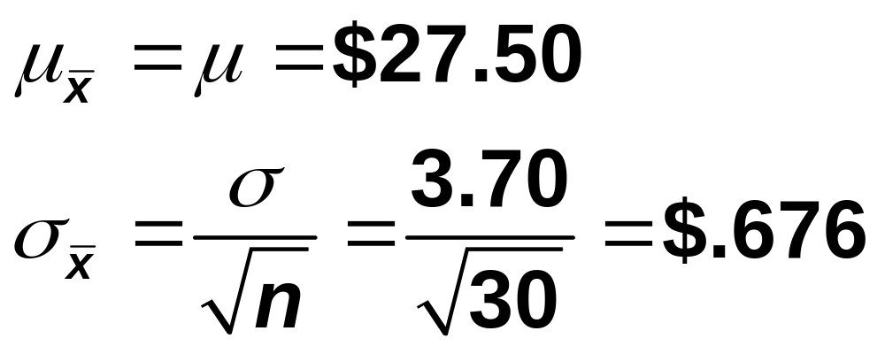
Solution
(a) N = 5000, μ = $27.50, σ = $3.70

Slide 19
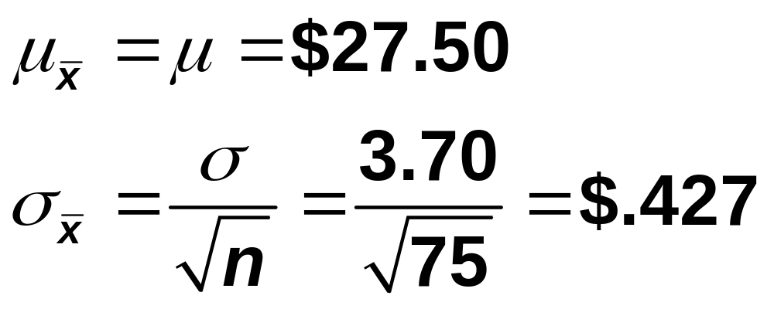
Solution
(b) N = 5000, μ = $27.50, σ = $3.70.

Slide 20
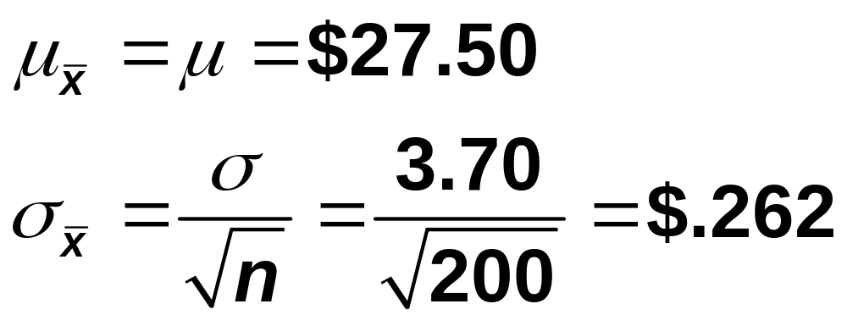
Solution
(c) N = 5000, μ = $27.50, σ = $3.70.

Slide 21
Shape of Sampling Distribution of
The population from which samples are drawn
    has a normal distribution &
    does not have a normal distribution.

Slide 22
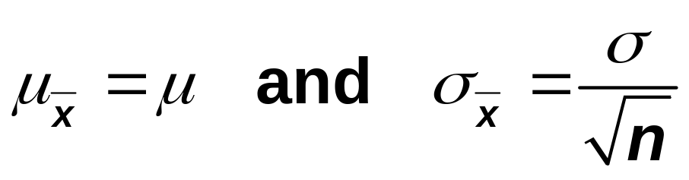
Sampling From a Normally Distributed Population
If the population from which the samples are drawn is normally distributed with mean μ and standard deviation σ, then the sampling distribution of the sample mean, , will also be normally distributed with the following mean and standard deviation, irrespective of the sample size:

Slide 23
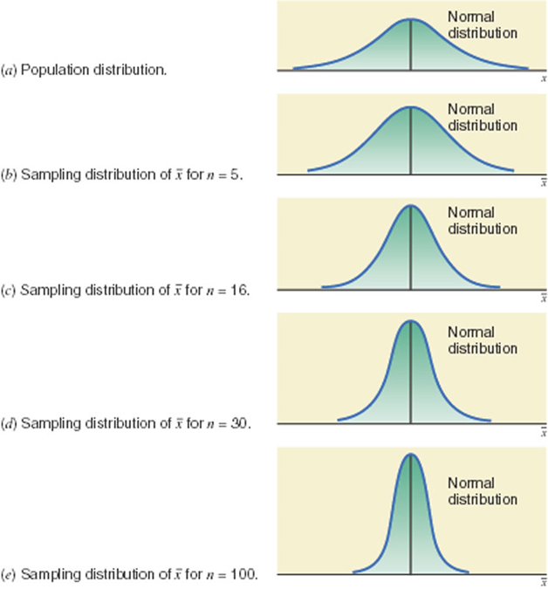
Population distribution and sampling distributions of

Slide 24
Example
In a recent SAT, the mean score for all examinees was 1020. Assume that the distribution of SAT scores of all examinees is normal with the mean of 1020 and a standard deviation of 153. Let be the mean SAT score of a random sample of certain examinees. Calculate the mean and standard deviation of and describe the shape of its sampling distribution when the sample size is
(a) 16 (b) 50 (c) 1000

Slide 25
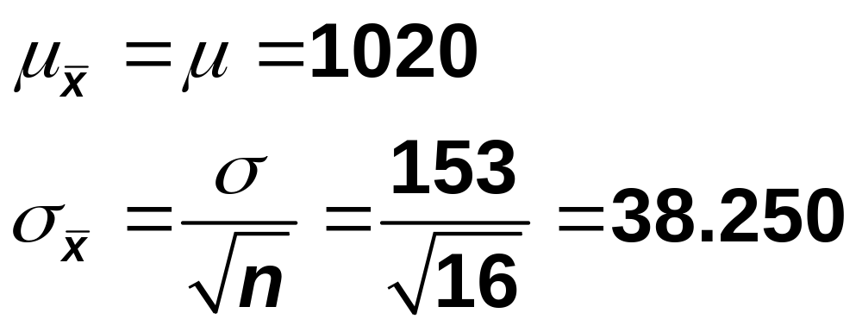
Solution
(a) μ = 1020 and σ = 153.

Slide 26
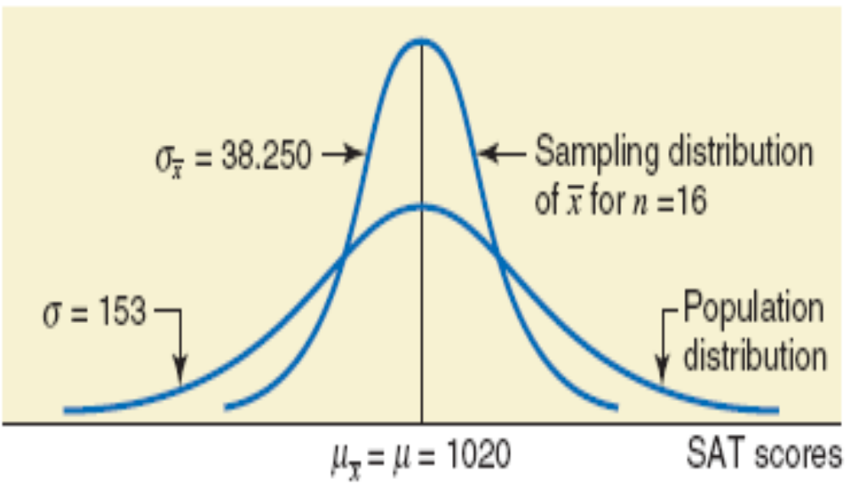
Shape

Slide 27
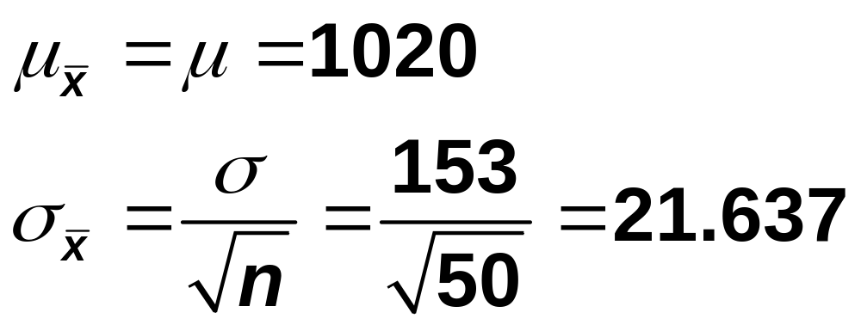
Solution
(b) μ = 1020 and σ = 153.

Slide 28
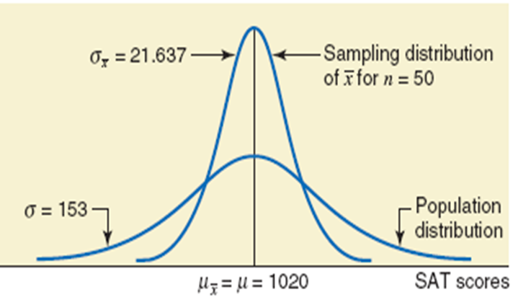
Shape

Slide 29
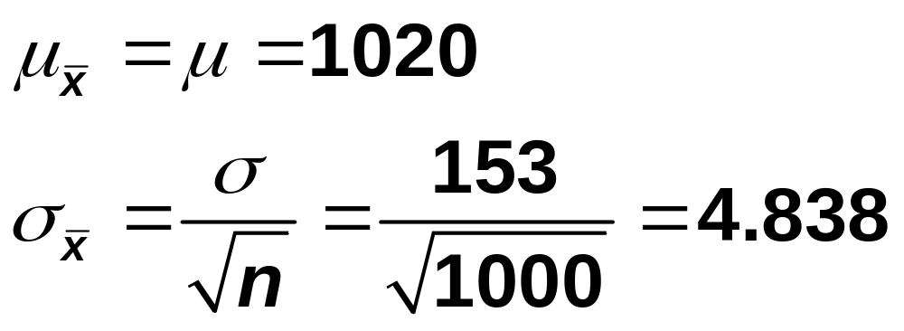
Solution
(c) μ = 1020 and σ = 153.

Slide 30
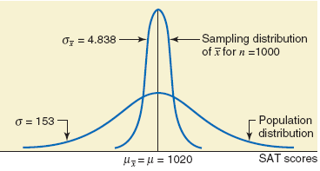
Shape

Slide 31
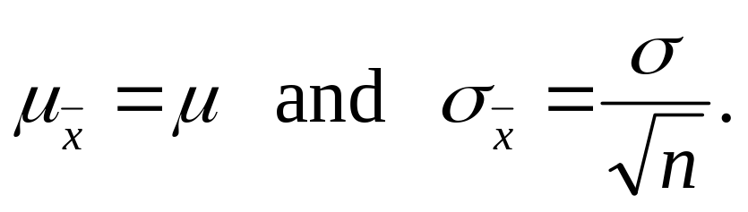
Sampling From a Population That Is Not Normally Distributed
Central Limit Theorem
According to the central limit theorem, for a large sample size, the sampling distribution of is approximately normal, irrespective of the shape of the population distribution. The mean and standard deviation of the sampling distribution of are
The sample size is usually considered to be large if n ≥ 30.

Slide 32
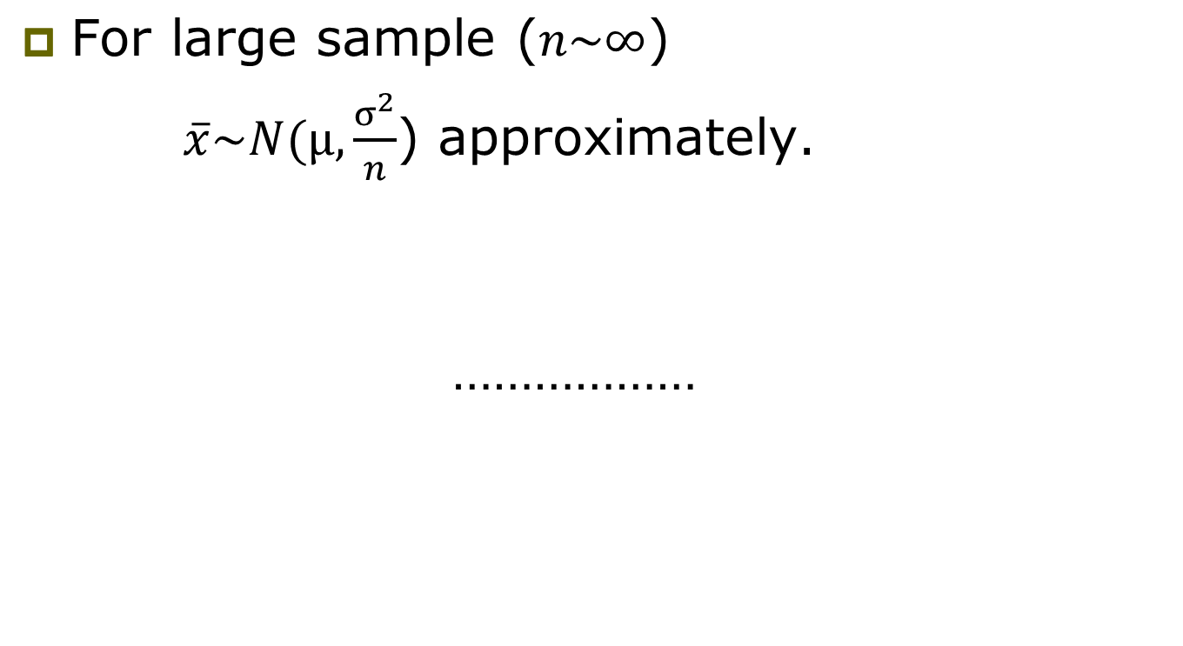
Central Limit Theorem

Slide 33
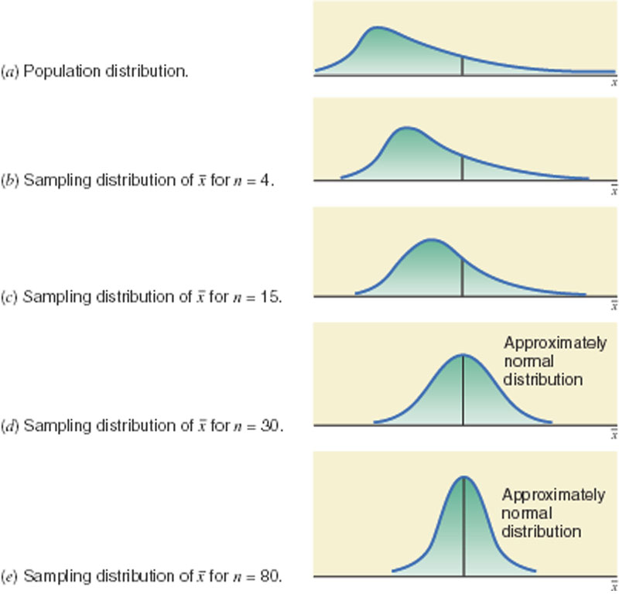
Population distribution and sampling distributions of

Slide 34
Example
The mean rent paid by all tenants in a small city is $1550 with a standard deviation of $225. However, the population distribution of rents for all tenants in this city is skewed to the right. Calculate the mean and standard deviation of and describe the shape of its sampling distribution when the sample size is
(a) 30 and (b) 100
HW: Above example for skewed to the left.

Slide 35
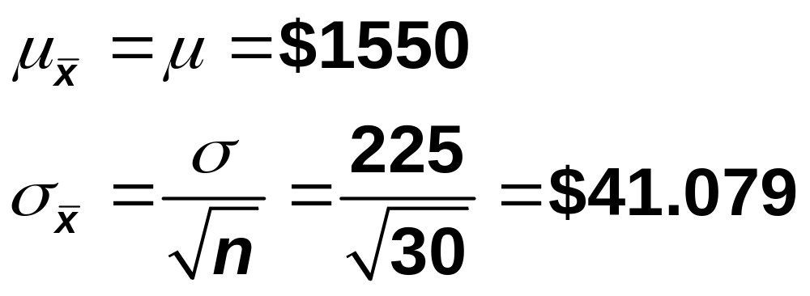
Solution
(a) Let be the mean rent paid by a sample of 30 tenants.

Slide 36
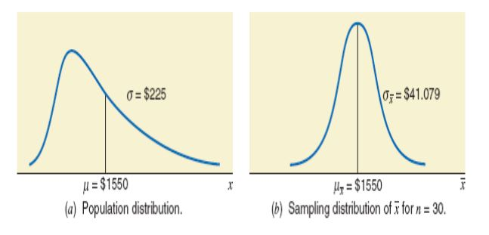
Shape

Slide 37
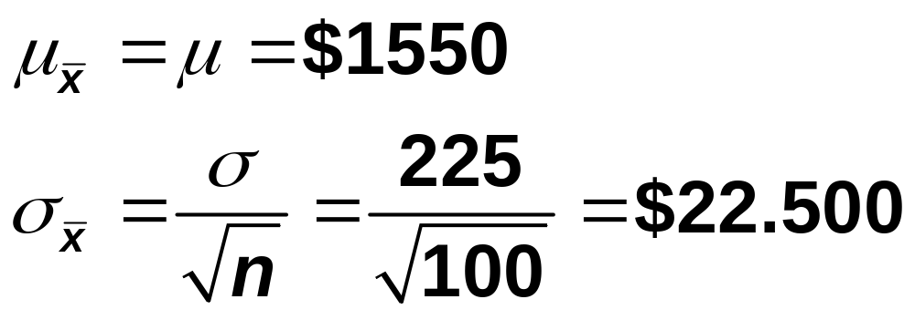
Solution
(b) Let be the mean rent paid by a sample of 100 tenants.

Slide 38
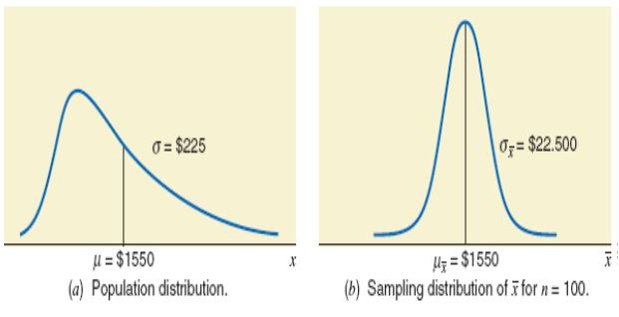
Shape

Slide 39
Applications of Sampling Distribution of
If we take all possible samples of the same (large) size from a population and calculate the mean for each of these samples, then about 68.26% of the sample means will be within one standard deviation of the population mean.

Slide 40
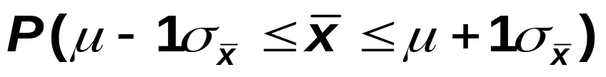
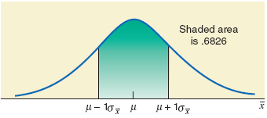
Figure

Slide 41
Applications of Sampling Distribution of
If we take all possible samples of the same (large) size from a population and calculate the mean for each of these samples, then about 95.44% of the sample means will be within two standard deviations of the population mean.

Slide 42
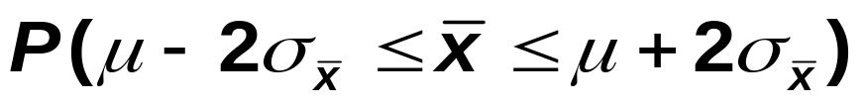
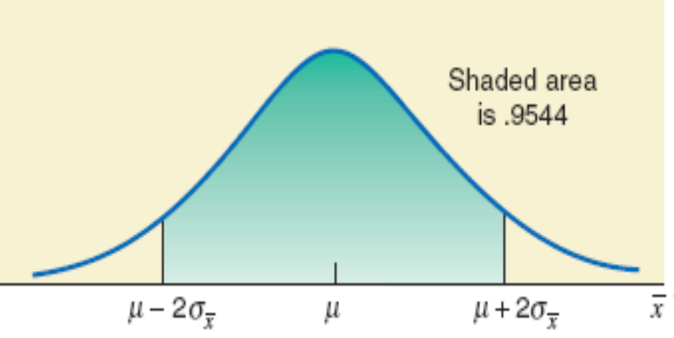
Figure

Slide 43
Applications of Sampling Distribution of
If we take all possible samples of the same (large) size from a population and calculate the mean for each of these samples, then about 99.74% of the sample means will be within three standard deviations of the population mean.

Slide 44
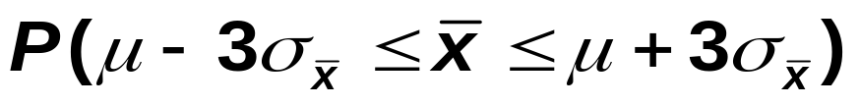
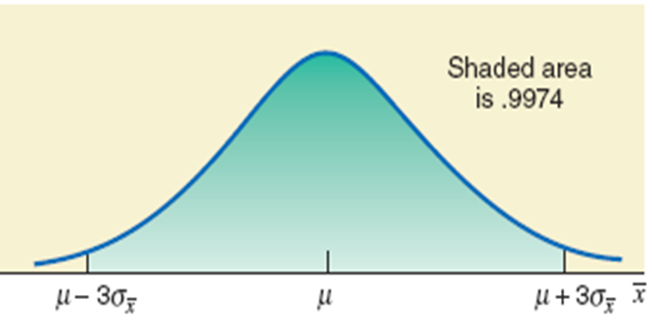
Figure

Slide 45
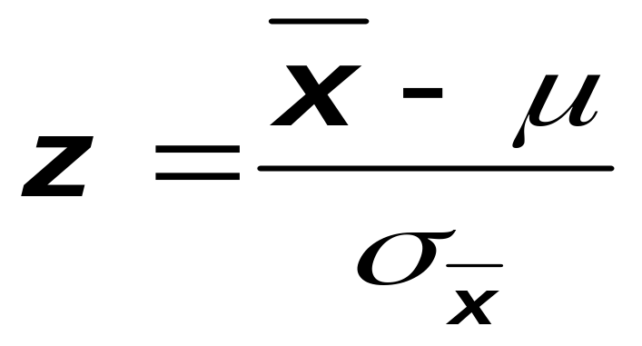
z Score for a Value of
The z score for a value of is calculated as

Slide 46
Example
Assume that the weights of all packages of a certain brand of cookies are normally distributed with a mean of 32 ounces and a standard deviation of 0.3 ounce. Find the probability that the mean weight, , of a random sample of 20 packages of this brand of cookies will be between 31.8 and 31.9 ounces.

Slide 47
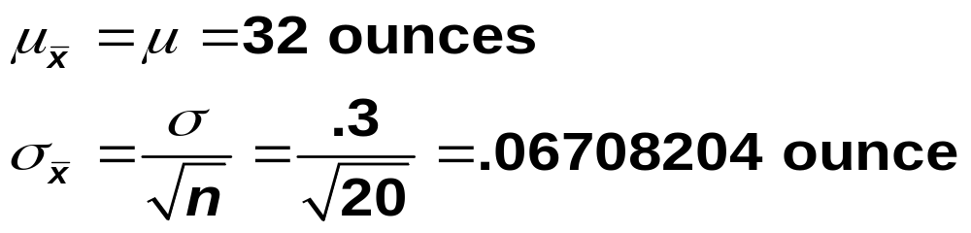
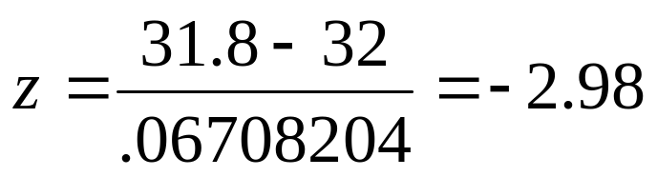
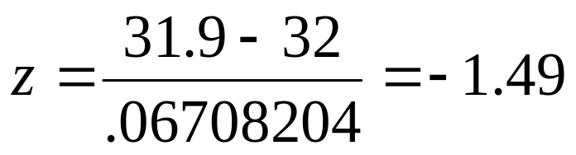
Solution
Here
For =31.8:
For =31.9:
P(31.8 < < 31.9) = P(-2.98 < z < -1.49)
= P(z < -1.49) - P(z < -2.98)
= 0.0681 - 0.0014 = 0.0667

Slide 48
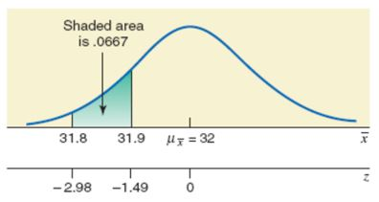
Figure

Slide 49
Example
According to Sallie Mae surveys and Credit Bureau data, college students carried an average of $3173 credit card debt in 2008. Suppose the probability distribution of the current credit card debts for all college students in the United States is known but its mean is $3173 and the standard deviation is $750. Let be the mean credit card debt of a random sample of 400 U.S. college students.

Slide 50
Example
What is the probability that the mean of the current credit card debts for this sample is within $70 of the population mean?
What is the probability that the mean of the current credit card debts for this sample is lower than the population mean by $50 or more?

Slide 51
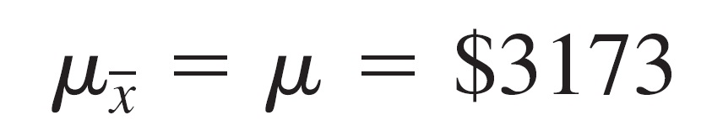
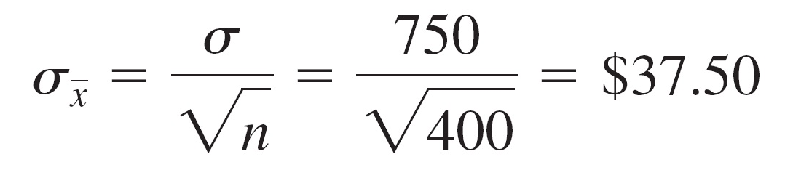
Solution
μ = $3173 and σ = $750.
The shape of the probability distribution of the population is unknown.
However, the sampling distribution of is approximately normal because the sample is large (n > 30).

Slide 52
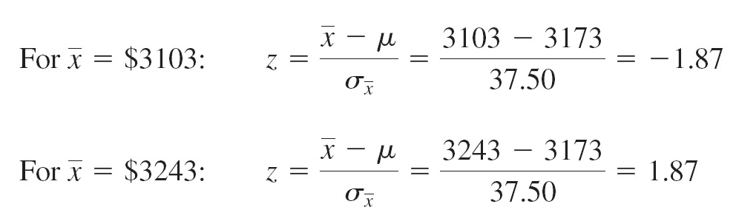
Example
(a)
P($3103 ≤ ≤ $3243)
= P(-1.87 ≤ z ≤ 1.87) = 0.9693 - 0.0307 =0.9386

Slide 53

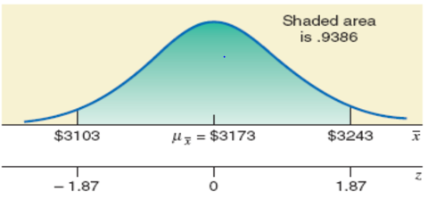
Figure

Slide 54
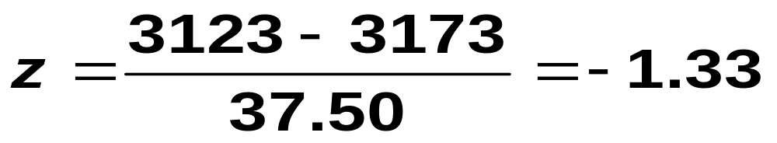
Solution
(b) For = $3123:
P( ≤ 3123) = P (z ≤ -1.33)
= 0.0918

Slide 55
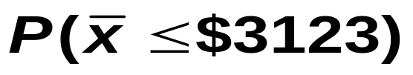
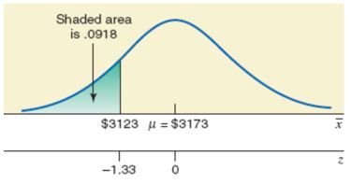
Figure

Slide 56

t, F and chi-square statistic
t:
Chi-square: Sum of square of independent standard normal varaites.
F: Ratio of two independent chi-square variates divided by their respective degrees of freedom.

Slide 57

F Distribution

Slide 58

Chi-square

Slide 59


Population and Sample Proportions
The population and sample proportions, denoted by p and , respectively, are calculated as

Slide 60
Population and Sample Proportions
where
  N = total number of elements in the population
  n = total number of elements in the sample
  X = number of elements in the population that possess a specific characteristic
  x = number of elements in the sample that possess a specific characteristic

Slide 61
Example
Suppose a total of 789,654 families live in a city and 563,282 of them own homes.
A sample of 240 families is selected from this city, and 158 of them own homes.
Find the proportion of families who own homes in the population and in the sample.

Slide 62

Solution

Slide 63


Sampling distribution of
Boe Consultant Associates has five employees. The information concerning their knowledge of statistics is:

Slide 64

Example
If we define the population proportion, p, as the proportion of employees who know statistics, then
p = 3 / 5 = 0.60
Now, suppose we draw all possible samples of three employees each and compute the proportion of employees, for each sample, who know statistics.

Slide 65

All Possible Samples of Size 3 and the Value of for Each Sample

Slide 66

Frequency and Relative Frequency Distribution of When the Sample Size Is 3

Slide 67
Sampling Distribution of When the Sample Size is 3
Home Work

Slide 68




Mean and Standard Deviation of
The mean of the sample proportion, , is denoted by and is equal to the population proportion, p. Thus,
The standard deviation of the sample proportion, , is denoted by and is given by the formula
where p is the population proportion, q = 1 – p, and n is the sample size.

Slide 69
Shape of the Sampling Distribution of
Central Limit Theorem for Sample Proportion
According to the central limit theorem, the sampling distribution of is approximately normal for a sufficiently large sample size. In the case of proportion, the sample size is considered to be sufficiently large if np and nq are both greater than 5 – that is, if
np > 5 and nq >5

Slide 70

z Value for a Value of
The z value for a value of is calculated as

Slide 71
Example
Maureen Webster, who is running for mayor in a large city, claims that she is favored by 53% of all eligible voters of that city. Assume that this claim is true.
What is the probability that in a random sample of 400 registered voters taken from this city, less than 49% will favor Maureen Webster?

Slide 72


Solution
n =400, p = 0.53, and q = 1 – p = 1 - 0.53 = 0.47
P( < .49) = P(z < -1.60)
= .0548
Hence, the probability that less than 49% of the voters in a random sample of 400 will favor Maureen Webster is .0548.

Slide 73


Figure
…………………….

